Slide 1





Iconnissance Computer Vision
Image recognition system for video game items
Henry Fan

Slide 2


Introduction
Objective, motivation, and approach

Slide 3
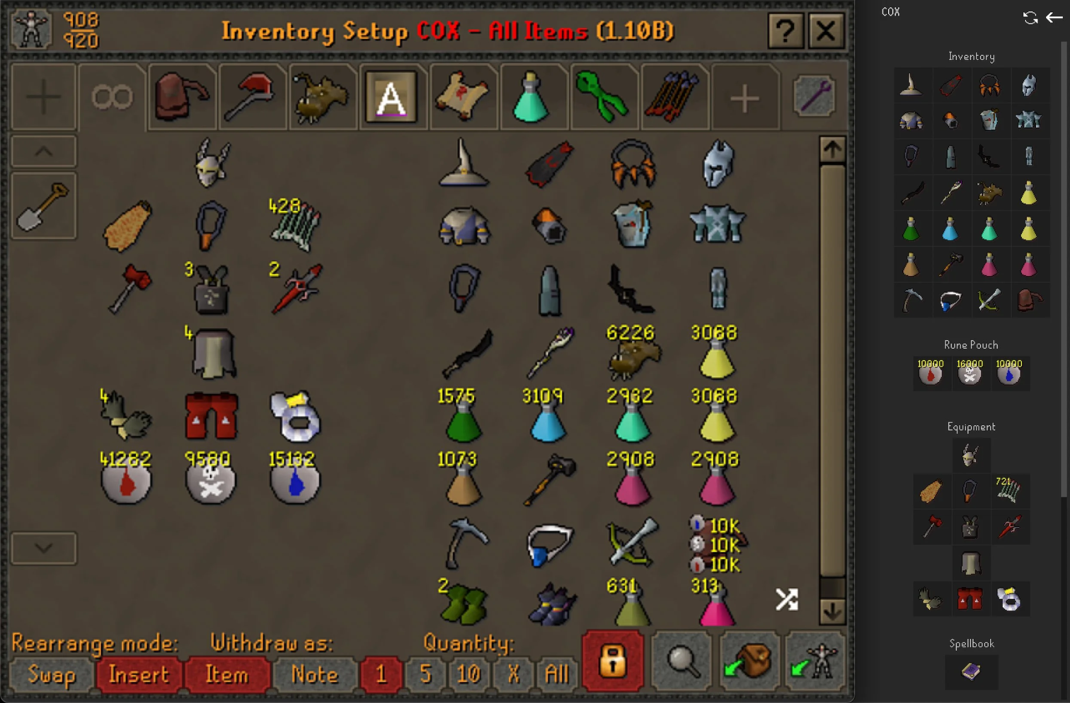
Objective
Icons!
Icons are used all the time in video games, graphic interfaces, etc, to represent objects and items.

Slide 4


Objective
INPUT
OUTPUT
Recognize
Small 2D square icons that represent common items in video games.
“Hammer”
“Ring”

Slide 5
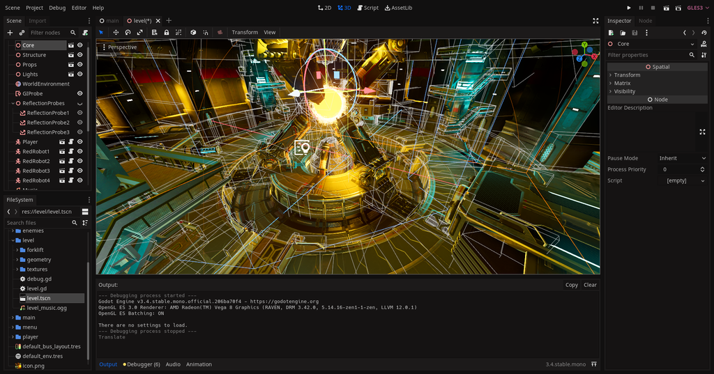
Game Development
Not just coding
Involves art, sound, storytelling, etc.
Not everyone can do all of that!

Slide 6



Approach to doing this?
Real world concepts represented by icons
Vary heavily in shape and orientation
Vary heavily in color and texture
Recognition techniques such as hough transform will not work for many cases!

Slide 7



Approach to doing this?
CNNs!
Adaptable to classes of different icons.
Already have a dataset of icons to train neural networks on.

Slide 8
Goals
Benchmarks and outcomes

Slide 9
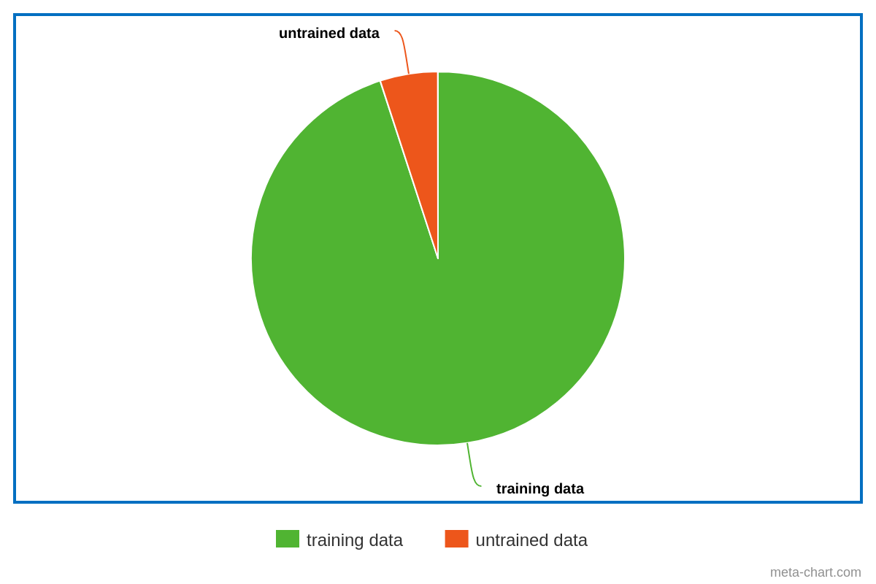
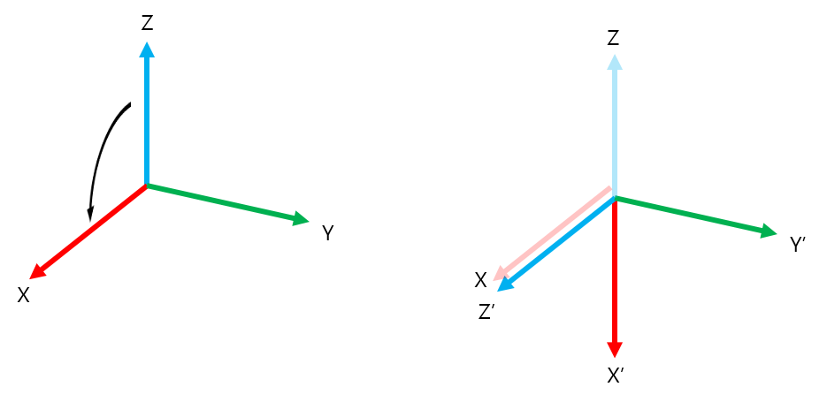
Benchmarks
Accuracy
To test the accuracy and ability of the model to categorize icons, a portion of the dataset will be reserved for testing the model performance on untrained data.
Unique images in the training set will be augmented with random transformations to improve performance with a small dataset.

Slide 10



Categorization Goals
Identify common video game objects for the following 12 categories:
['boots', 'axes', 'shields', 'helmets', 'ingot', 'potions', 'pants', 'swords', 'gloves', 'armors', 'rings', 'gems']
Reach goal: be able to identify objects with very different art styles from training data, such as Minecraft

Slide 11
Resources
A list of resources used for this project
Information:
https://datagen.tech/guides/image-classification/python/#
https://www.geeksforgeeks.org/python-image-classification-using-keras/
Libraries:
Tensorflow: https://www.tensorflow.org/tutorials/images/classification
Keras: https://keras.io/
Numpy: https://numpy.org/
Matplotlib: https://matplotlib.org/
Pathlib: https://docs.python.org/3/library/pathlib.html

Slide 12
The end!

